Slide 1
SAP
SALES & DISTRIBUTION

Slide 2
ENTERPRISE STRUCTURES

Slide 3
ENTERPRISE STRUCTURE
The Enterprise Structure represents the business structure in the real world. You can map various organizational units to enterprise structure as per the requirement like – Client, Distribution channel, division, company code, Sales office, Shipping Point, Loading point, etc…
To represent complex corporate structures flexibly.
To adapt to changes the corporate structure.
To process data across company code.

Slide 4
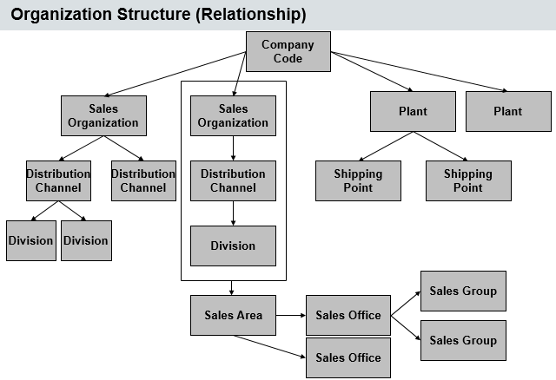
Enterprise structures

Slide 5
Organizational units
Company code
Sales Area
Sales Organization
Distribution Channel
Division
Plant
Storage Location
Shipping Point

Slide 6

COMPANY
A company is the organizational unit in SAP FI for which you can draw individual financial statements, according to the legal requirements of the country where it’s incorporated. You can designate legally dependent branches as companies and join them together as legal units by consolidation

Slide 7
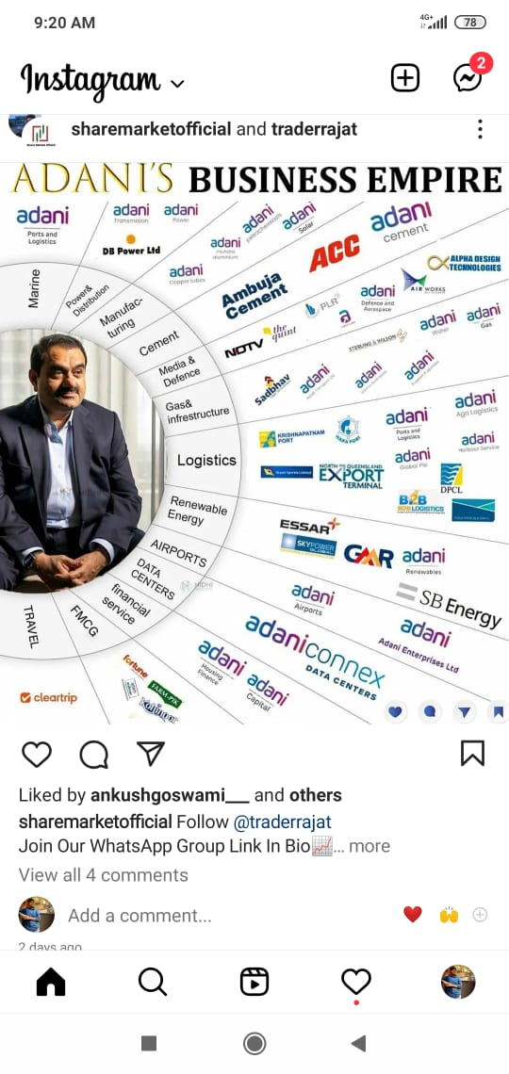

Slide 8
COMPANY CODE
Company Code in SAP is the smallest Organizational unit of external accounting for which you can create a completely self-contained set of accounts for transaction posting, besides the statutory financial statements.
Company code is a legal entity and independent accounting unit
At company code level we can create Balance Sheet required by law
Profit and loss statement

Slide 9
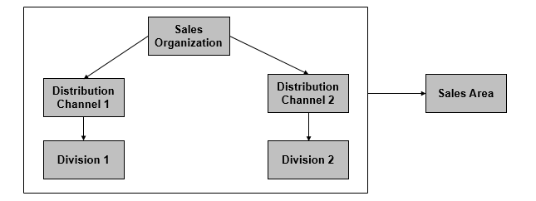
SALES AREA

Slide 10

SALES ORGANIZATION
Sales Organization is at Highest level of organizational unit in Sales and Distribution.
Responsible for Distribution of goods and services.
A sales organization is assigned to only one company code and one or more plants.

Slide 11
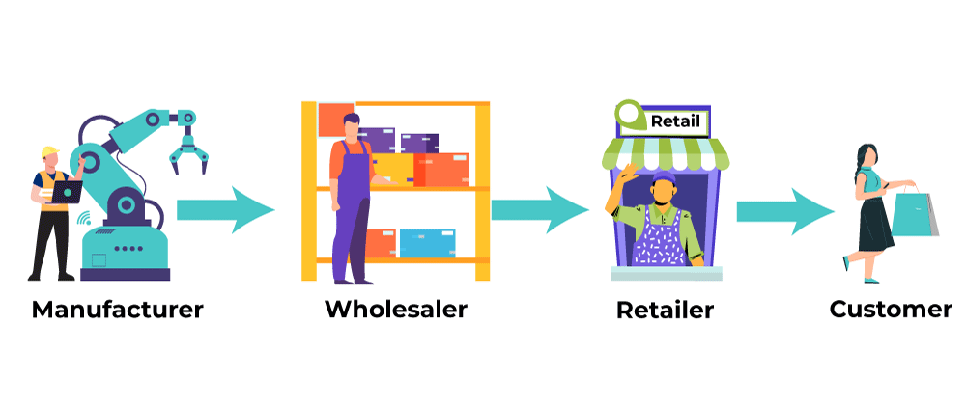
DISTRIBUTION CHANNEL
The Distribution Channel represents the channel through salable material or services reach the customers.
Represents your strategies to distribute goods and services to your customers.
Examples : Wholesale trade, Retail trade, Internet trade and so on…

Slide 12
DIVISION
Division is a method of dividing products and services into different categories.
A division can represent a certain product group. You can therefore restrict Price Agreement with a customer to a particular division.
Several divisions can be assigned to a sales organization.
Examples : Motorcycles, Spare parts, Services and so on..

Slide 13
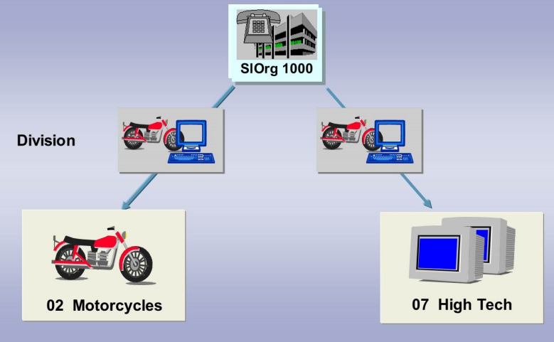
division

Slide 14
PLANT
A Plant is a location where material stock is kept, and could represent a production facility in the system.
A Plant that is used within a sales and distribution process is also called Delivering Plant.
Each Plant is uniquely assigned to a company code.

Slide 15
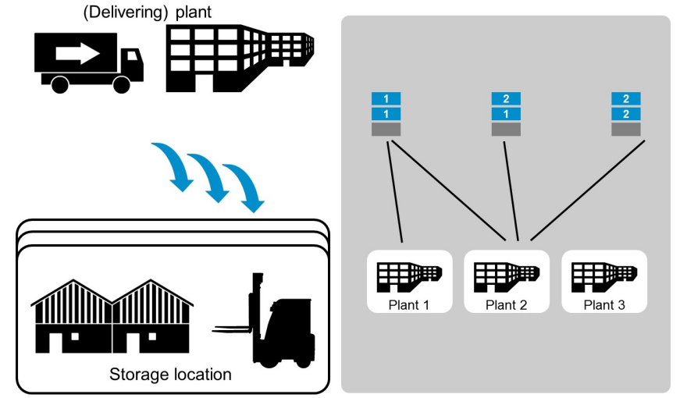
plant

Slide 16
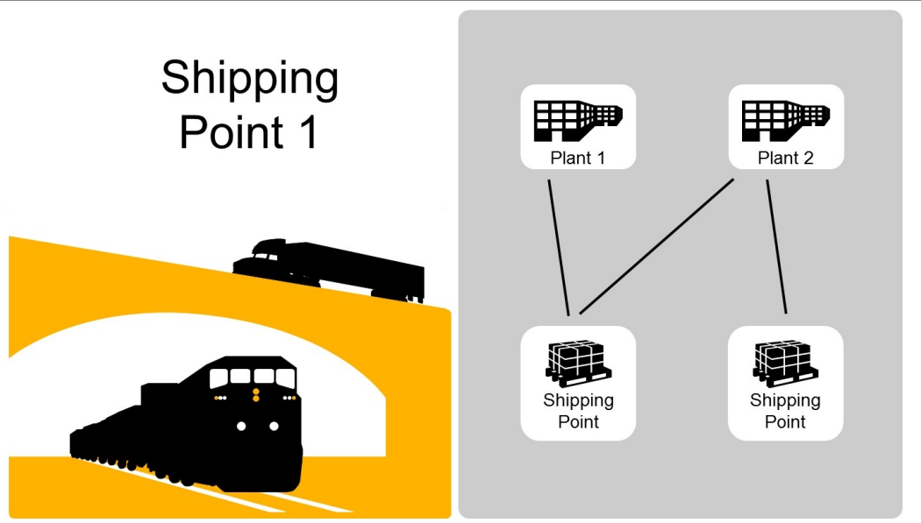
Shipping point
Shipping point indicate the point at which the title of goods transfer form the seller to buyer.
It is the highest level organizational unit of shipping that controls your shipping activities.
Each shipping point has to be assigned to at least one plant.

Slide 17
MASTER DATA

Slide 18
MATER DATA IN SALES & DISTRIBUTION
Customer Master Data
Material Master Data
Customer – Material info Records
Condition Master Data
Output Master Data

Slide 19
Customer master data
To maintain detailed information about customer details such as Name, Address, Control data, Payment details etc..
Customers Are :
Sold to Party
Ship to Party
Bill to Party
Payer

Slide 20
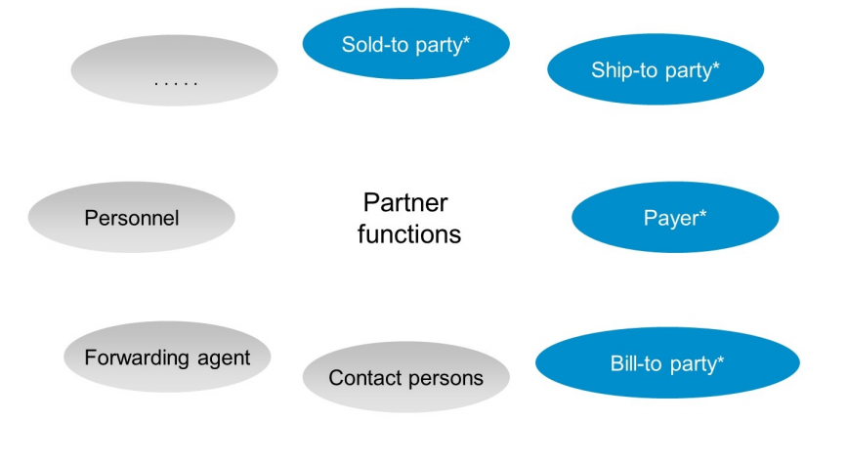

Slide 21
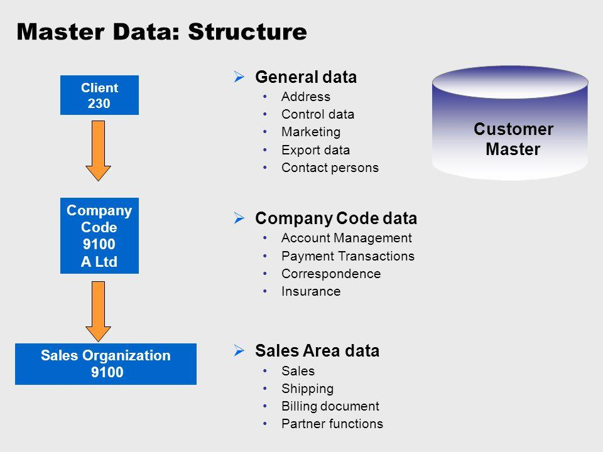

Slide 22
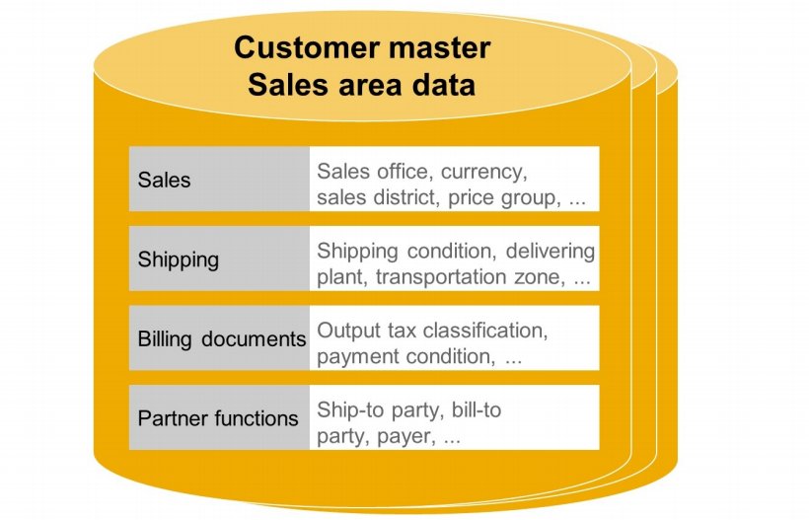

Slide 23
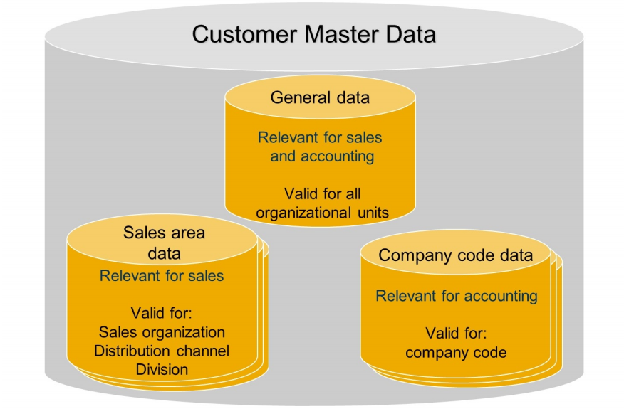

Slide 24
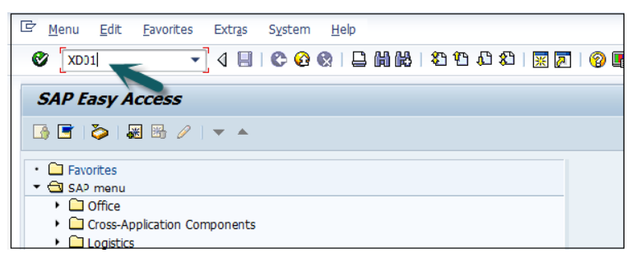

Slide 25
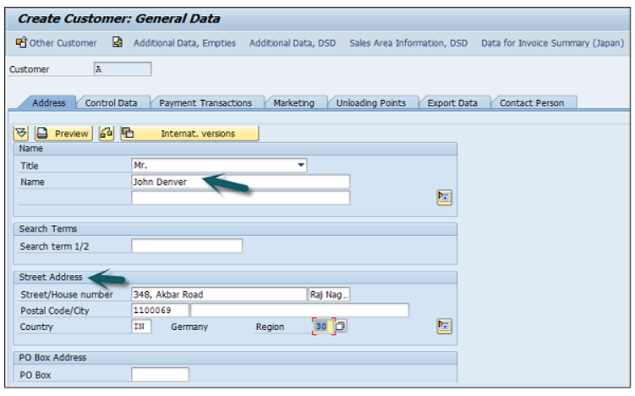

Slide 26
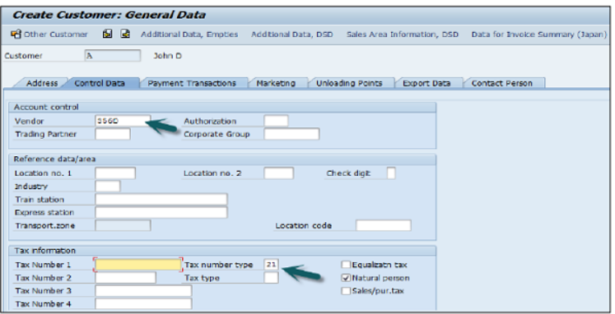

Slide 27
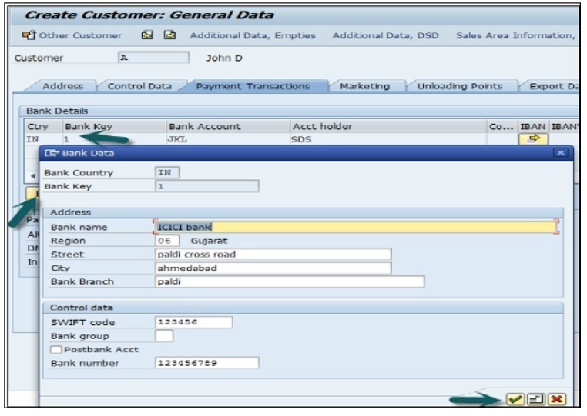

Slide 28
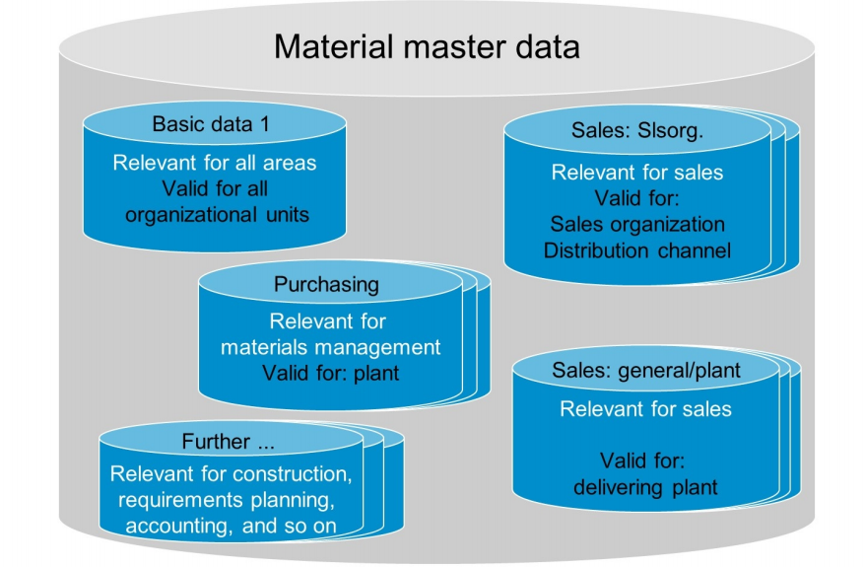
Material master data
Within the Material Mater Data you can maintain detailed information about particular material (such as the Description, Weight, or Tax relevance)

Slide 29
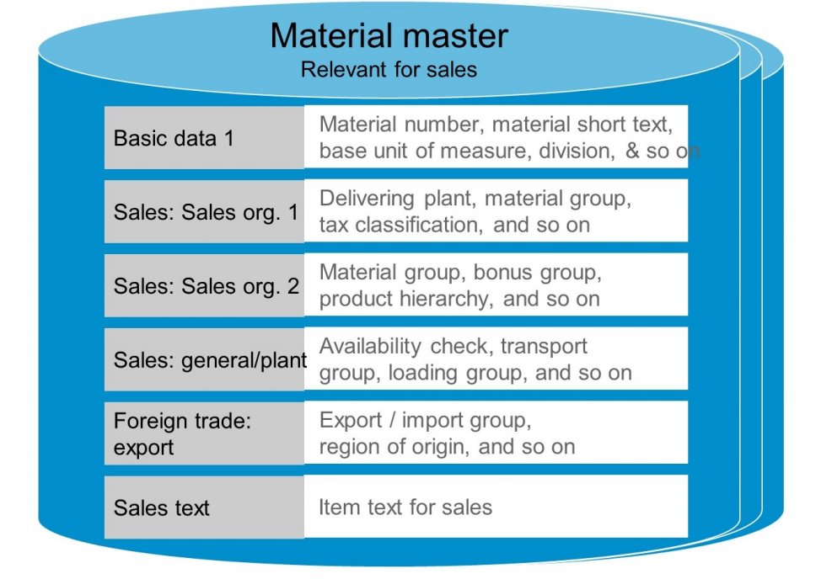

Slide 30
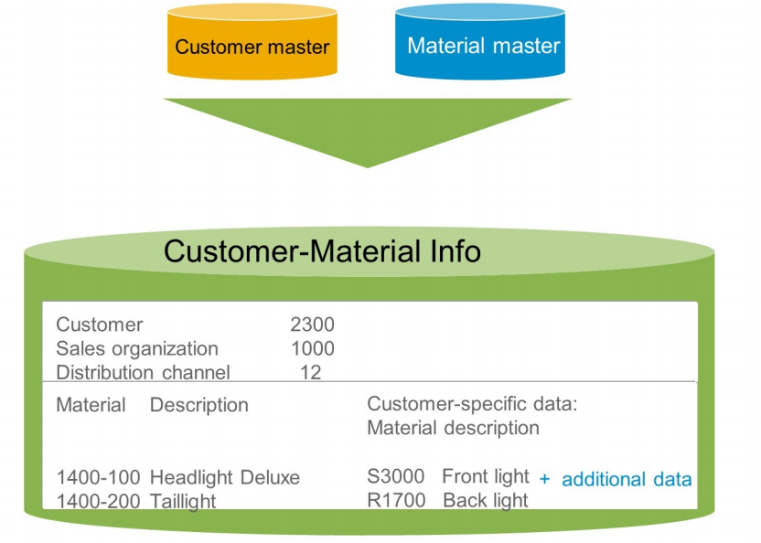
CUSTOMER Material INFO RECORDS
CMIR is used to process specific material for a specific customer.
Used for storing data in combination of Customer and Material.
You can record specific and specialized information about a Material which is specific to a Customer

Slide 31
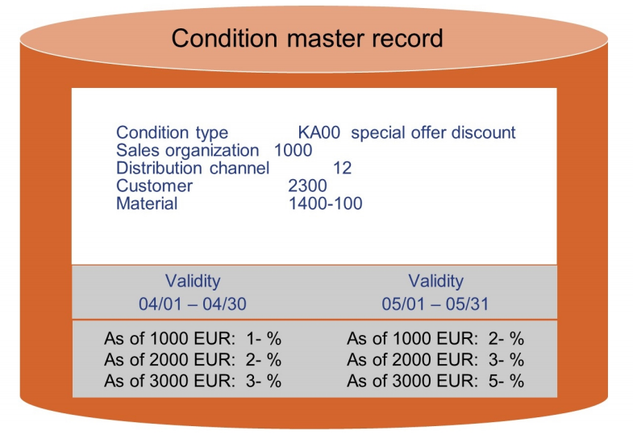
CONDITION MASTER DATA FOR pRICING
A condition record is defined as how system stores the specific condition.
You define pricing for the product or service you are selling to your customers.
For example, a particular customer orders a certain quantity of a particular product on a certain day.

Slide 32
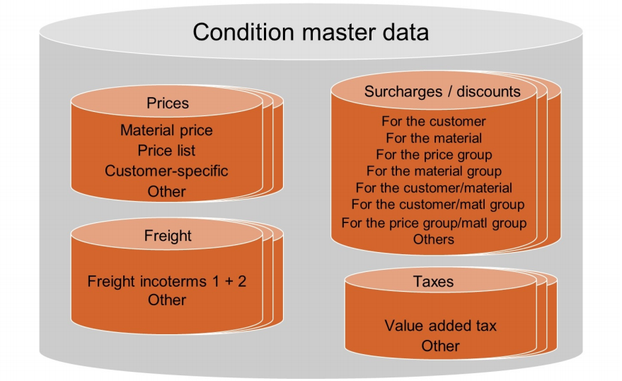
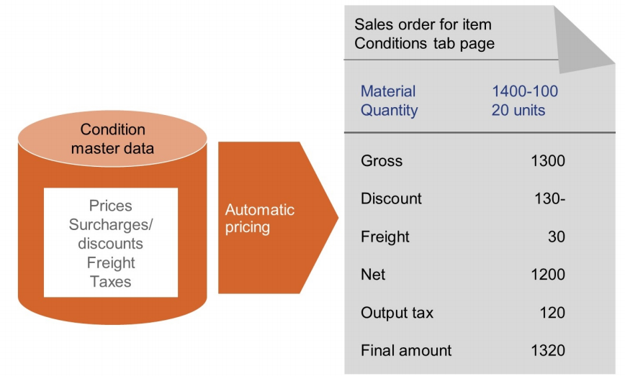

Slide 33
OUTPUT master data
You can define how to communicate and send specific information to your customer, at what time, by what means and to which business partner of your customer.
For example, a customer has sent you a request for quotation.

Slide 34
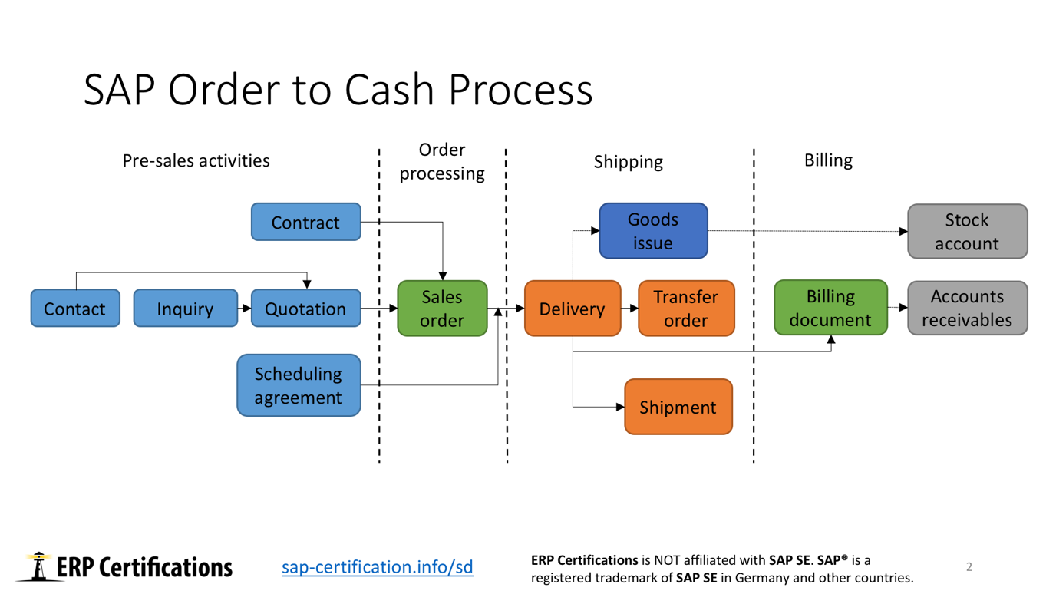

Slide 35
Pre Sales Documents
Inquiries :
An Inquiry is a request from a customer to a vendor for sales information: price, availability, delivery date... It is not a legal documents.
Quotations :
A Quotation is a legal document to the customer for delivery of goods and services. This is normally issued after an inquiry from the customer.

Slide 36
ORDER PROCESSING
SALES ORDER :
A Sales order is a request made by a customer to the company for delivery of some defined quantity of goods or a service in a specific time period.
Its Contain :
Customer and Material information
Information about delivery date and delivery quantities.
Information about Price
Information about shipping process

Slide 37
Structure of the Sales Documents
Three Levels of Sales Documents :
Header
Item
Schedule line

Slide 38
Header Level
The data for the Document Header valid for the entire document. This includes, Ex : Document Number and Customer related data like relevant Sold-to-party.

Slide 39
ITEM LEVEL
Each item in the sales document contains its own data. this includes, Ex : data about the ordered materials and corresponding quantities.

Slide 40
SCHEDULE LINE LEVEL
Schedule line contains delivery quantities and delivery dates. They clearly belong to an item. Ex : the ordered quantity is to be delivered in several partial deliveries at different time.

Slide 41
OUTBOUND DELIVERY
This is the basic document for the different activities during the shipping process like :
Picking
Packing
Posting Goods Issue
You can create one or more outbound deliveries with reference to a single order.

Slide 42
TRANSFER ORDER
The Transfer order is essential for controlling the goods movements with in a warehouse.
The main function of a transfer order is to indicate where the goods should be taken from and brought within the warehouse.

Slide 43
POST GOODS ISSUE
Posting the goods issue is often the final step in the shipping process.
It is the goods owner ship is moved to the customer and stock is updated as per delivery.

Slide 44
BILLING DOCUMENT
In SAP Sales and Distribution module, billing is known as the final stage for executing business transactions. When an order is processed and delivery is made, billing information is available at each stage of this order processing.
A billing document is created for a credit memo, debit memo, an invoice or a cancelled transaction. Each billing document has a header and list of items under it. Billing documents are normally controlled by the billing type.

Slide 45
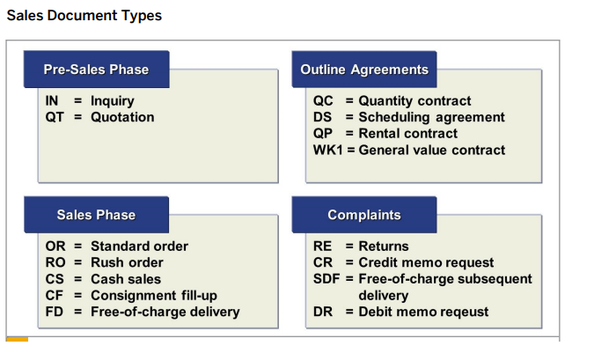
SALES DOCUMENT TYPES

Slide 46
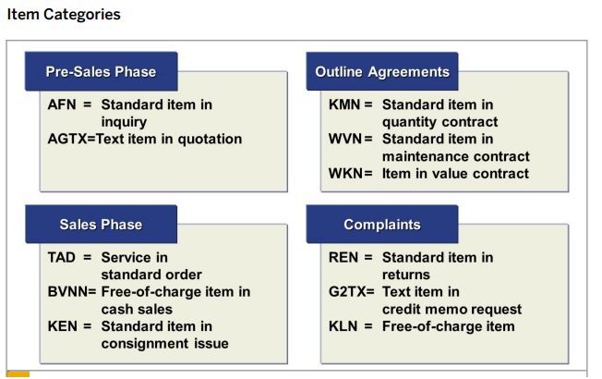
ITEM CATEGORY

Slide 47
MATERIAL LISTING & EXCLUSION
Material Listing and Material Exclusion lets you control which material specific customers may or may not buy..

Slide 48
MATERIAL LISTING
Customer receives only specific materials. Material listing is customized by the condition technique.
Master records have been created with a key combination for the customer and material numbers. You can also define your own key combinations.
Examples:
Customer group/material
Customer/product hierarchy

Slide 49
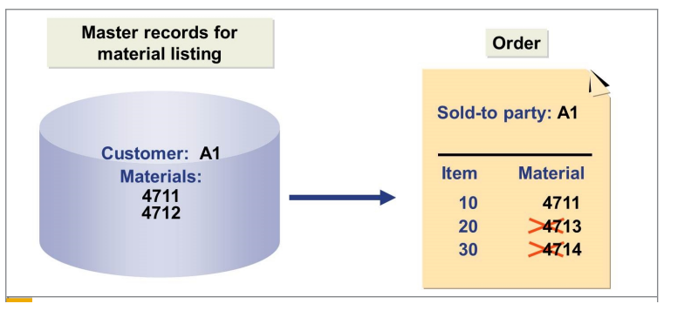

Slide 50
MATERIAL EXCLUSION
You want to ensure that the customer does not receive certain materials. You enter these materials as a material exclusion for that customer.
The material exclusion is also customized by the condition technique.

Slide 51
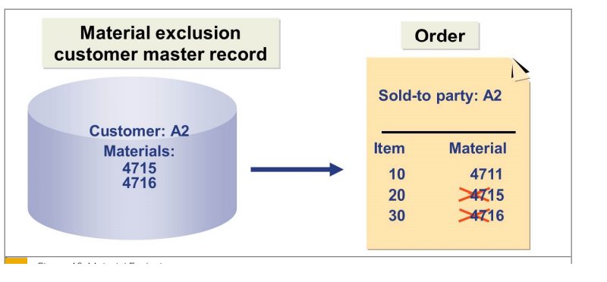

Slide 52
FREE GOODS
In industry sectors such as the retail industry, the chemical industry, or the consumer goods industry, it is common to provide discounts in the form of free goods.

Slide 53
Inclusive
Free goods can be part of the order quantity that is not included in the invoice. This quantity is called an inclusive bonus quantity.
The ordered goods and the free goods both involve the same material.
The quantity units of the free goods and ordered goods must be the same.

Slide 54
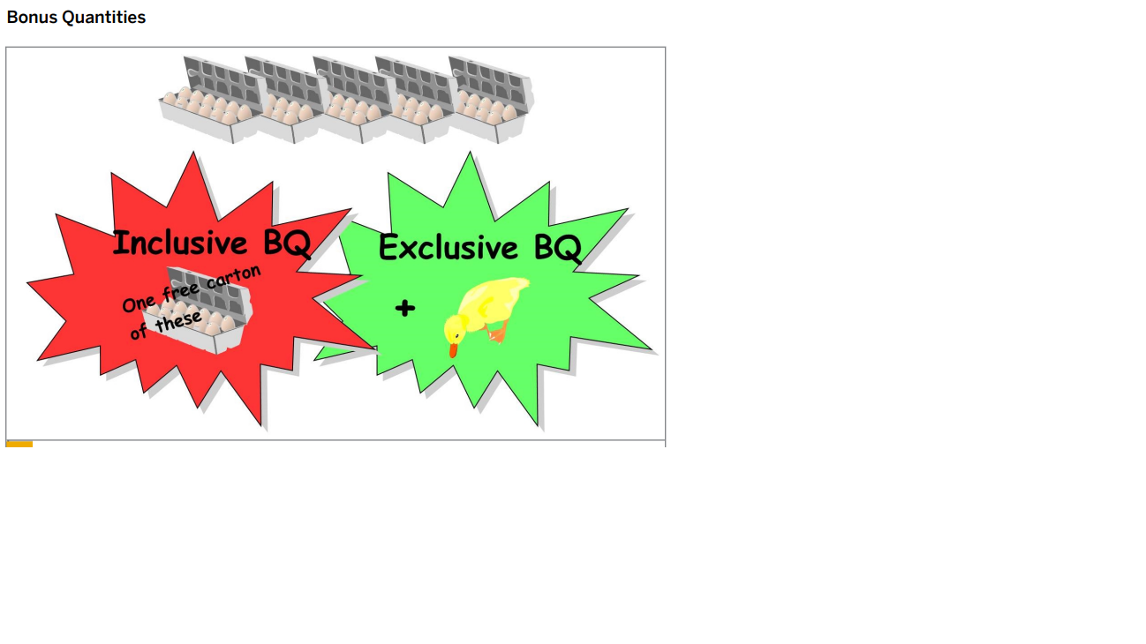

Slide 55
EXCLUSIVE
Free goods can also be extra goods that are free of charge and are not included in the invoice.
These extra goods are called exclusive bonus quantities.
These extra goods can be an additional quantity of the ordered goods, or they can be another material.

Slide 56
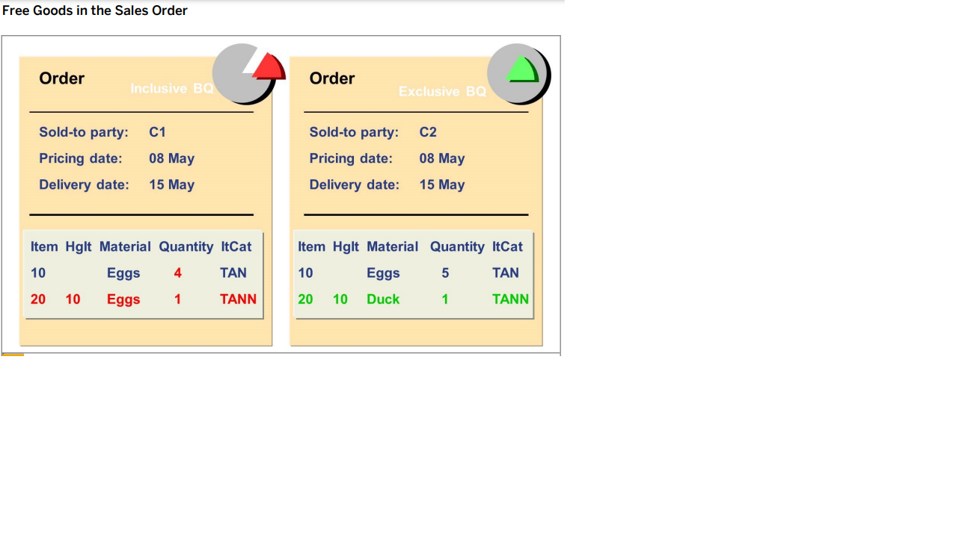

Slide 57
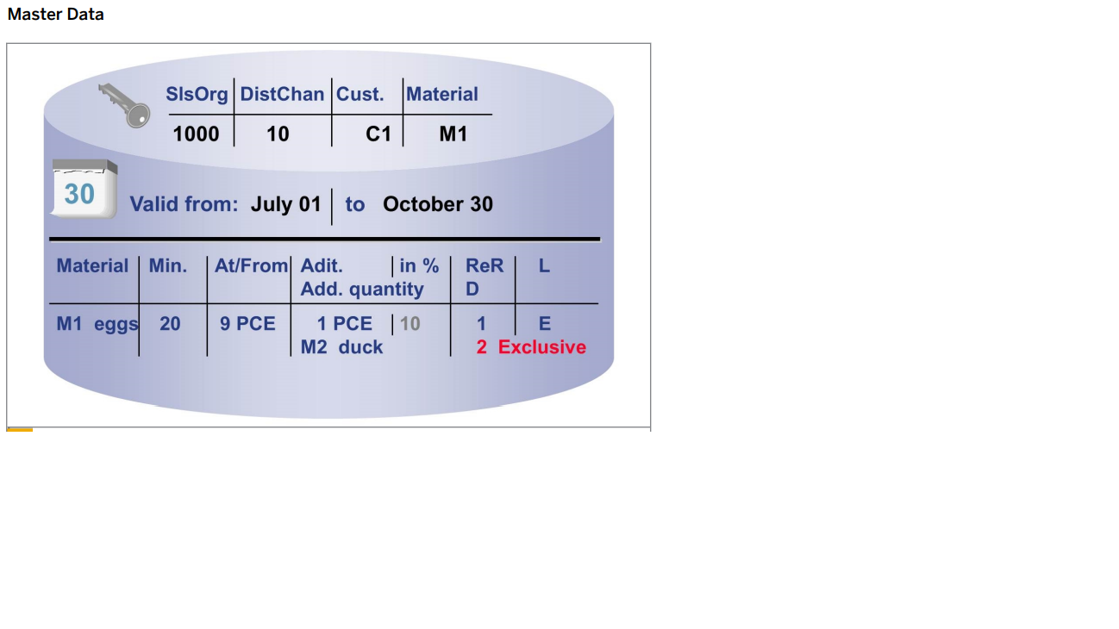

Slide 58
TAN &TANN
Both types of free goods, inclusive and exclusive, are handled in the same way in the sales order.
The material that has been ordered is entered as a main item and the free goods material is automatically displayed as a sub-item.
If the quantity of the main item changes or if the pricing date changes, the system re-reads the free goods master record in the sales order.
The system then deletes the sub-items and re-creates them.
Any manual changes to the free goods quantity are lost.
If pricing is re-run in the sales order, it does not affect the determination of free goods.

Slide 59
Calculation Rule
Rule Significance
Rule 1 Pro rata
Rule 2 Unit reference to units
Rule 3 Whole units
Rule ## Your own rule

Slide 60
You offer to supply 20 units of free goods for a free goods quantity of 100 units. The customer orders 162 units (document quantity).
The calculation rules are as follows:
● Rule 1 (prorated)
32 units of free goods (162*(20/100) = 32.4, which is rounded down to 32)
● Rule 2 (related to units)
20 units of free goods (100*(20/100) = 20)
● Rule 3 (whole units)
0 units of free goods (162 is not a complete unit of 100)
Calculation rules are stored in the system in the form of ABAP/4 code. You can also define your own rules (transaction VOFM , menu item Formula ).

Slide 61
SHIPPING POINT DETERMINATION
Shipping Condition
Loading Group
Delivering Plant

Slide 62
PLANT DETERMINATION
Customer - Material Info Record
Customer Master data
Material Master data

Slide 63
INTRODUCING PRICING
Pricing in Sales and Distribution is used to define the calculation of prices for external vendors or customers and cost. This condition is defined as a set of conditions when a price is calculated.
Condition Master Data
Structure of Condition Records
Examples of Condition Types

Slide 64
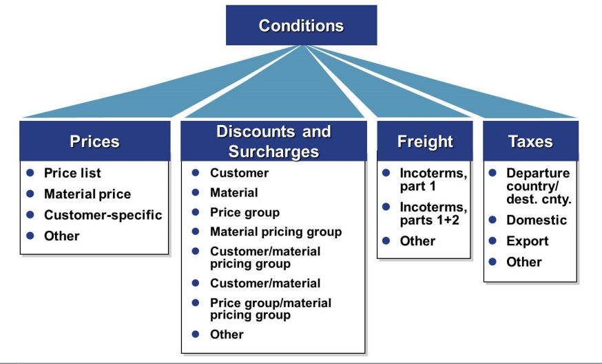
CONDITION MASTER DATA

Slide 65
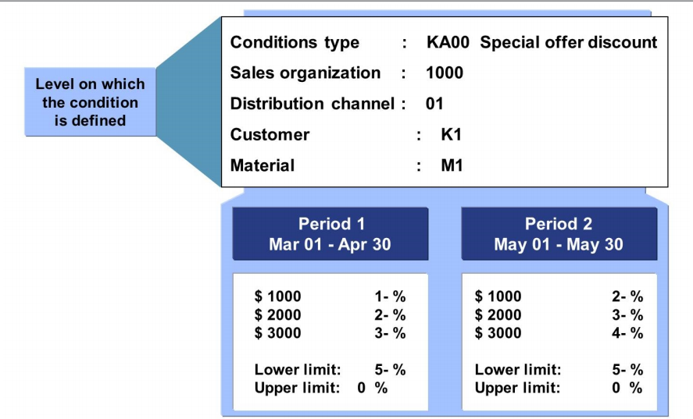
STRUCTURE OF CONDITION RECORDS

Slide 66
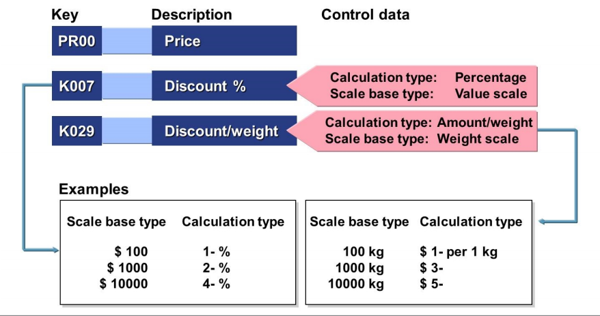
CONDITION TYPES

Slide 67
Introducing the Condition Technique
Pricing Procedure Determination
Condition Types
Access Sequence
Condition Table
Condition Record
Final Price

Slide 68
Pricing Procedure Determination
Sales Area
Sales Document ( Document pricing procrdure )
Sold-to-party ( Customer pricing procedure )

Slide 69
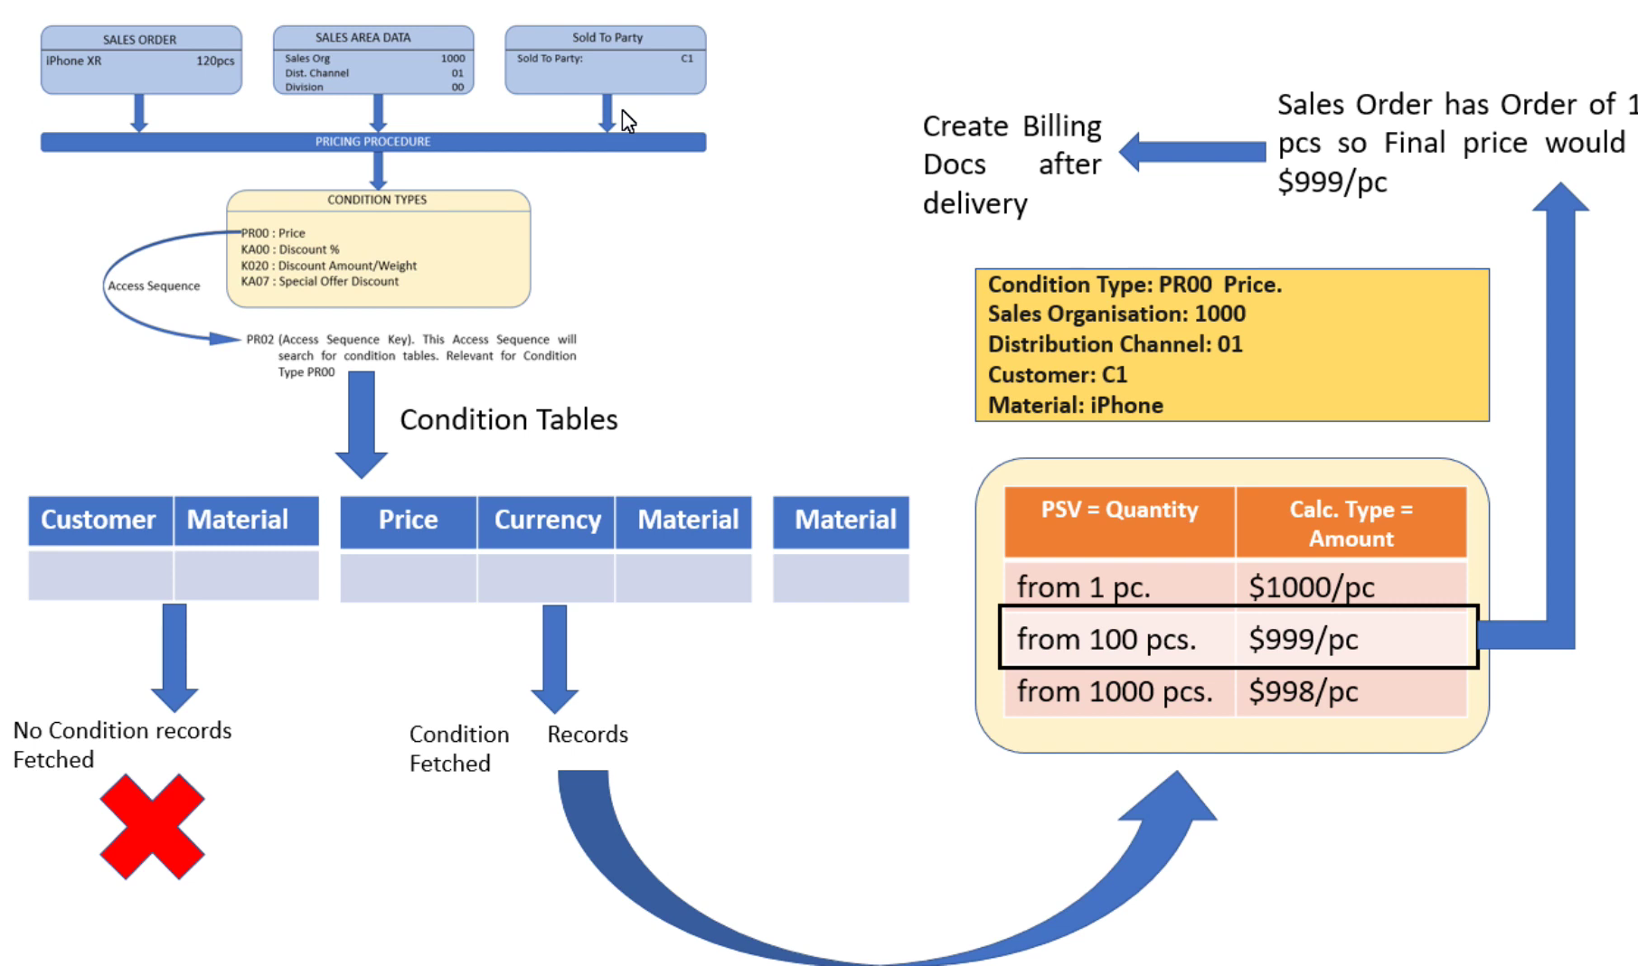

Slide 70
CONDITION TYPE
A condition type is a representation in the system of some aspect of your daily pricing activities. For example, you can define a different condition type for each kind of price, discount, or surcharge that occurs in your business transactions.
PR00 - Price
K004 - Material Discount
K005 - Customer - Specific Material Discount
K007 - Customer Discount
K020 - Price Group Discount
KF00 - Freight Surcharge
UTX1 - State Tax
UTX2 - Country Tax
UTX3 - City Tax

Slide 71
ACCESS SEQUENCE
An access sequence is a search strategy that the system uses to find valid data for a particular condition type. It determines the sequence in which the system searches for data. The access sequence consists of one or more accesses.

Slide 72
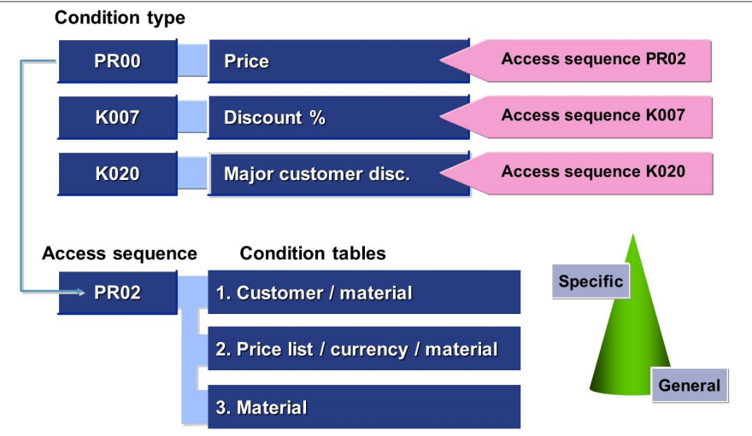
ACCESS SEQUENCE

Slide 73
CONDITION TECHNIQUE
CONDITION TABLE
A Condition table is defined as a combination of keys to identify an individual condition record
CONDITION RECORD
A condition record is defined as how system stores the specific condition. Example of a Condition Record − Entering the price of a product or to specify the discount for a privileged customer.

Slide 74
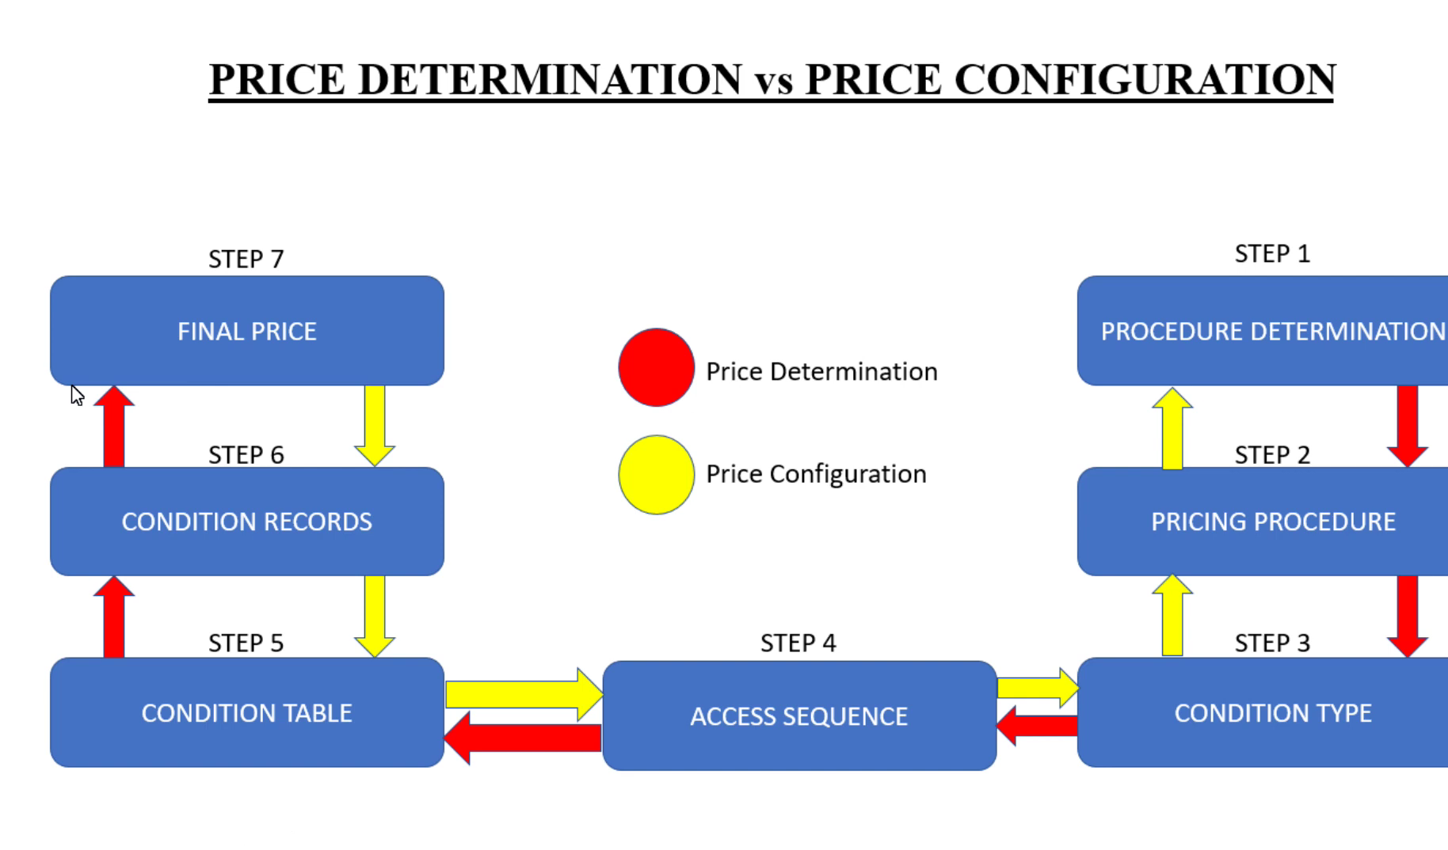
PRICING CONFIGURING

Slide 75
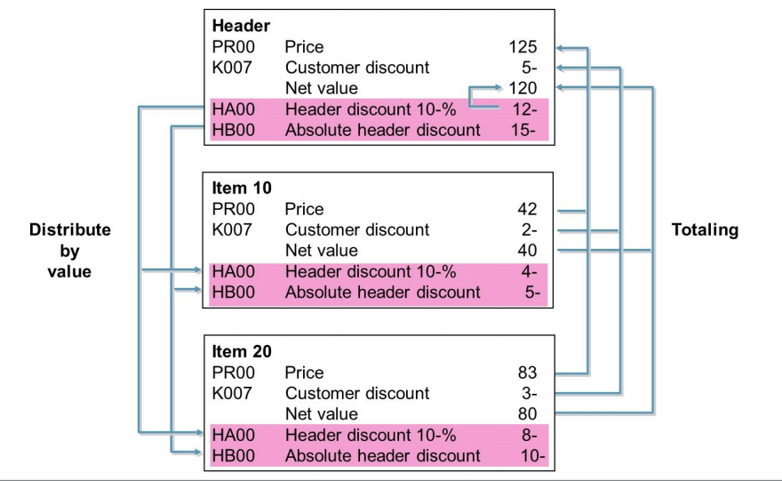
HEADER CONDITION

Slide 76
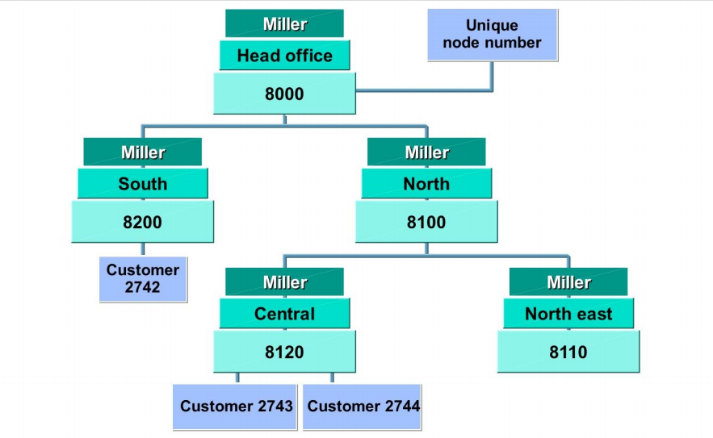
CUSTOMER HIERARCHY

Slide 77
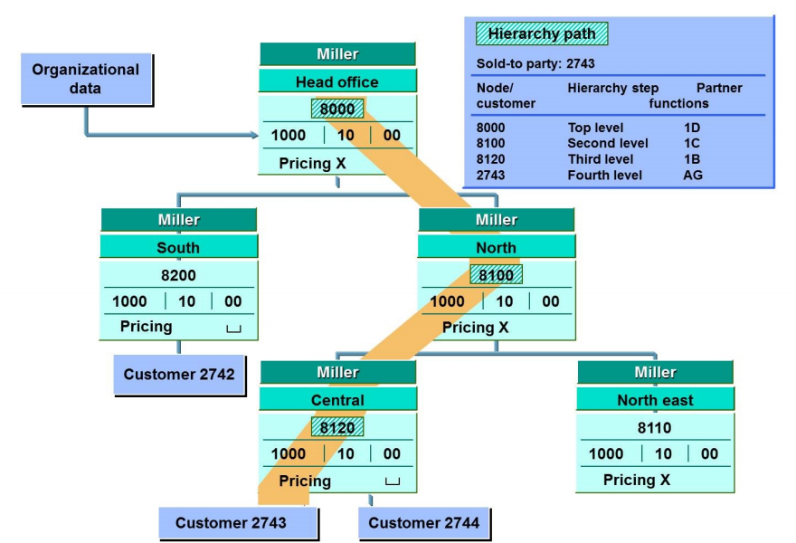

Slide 78
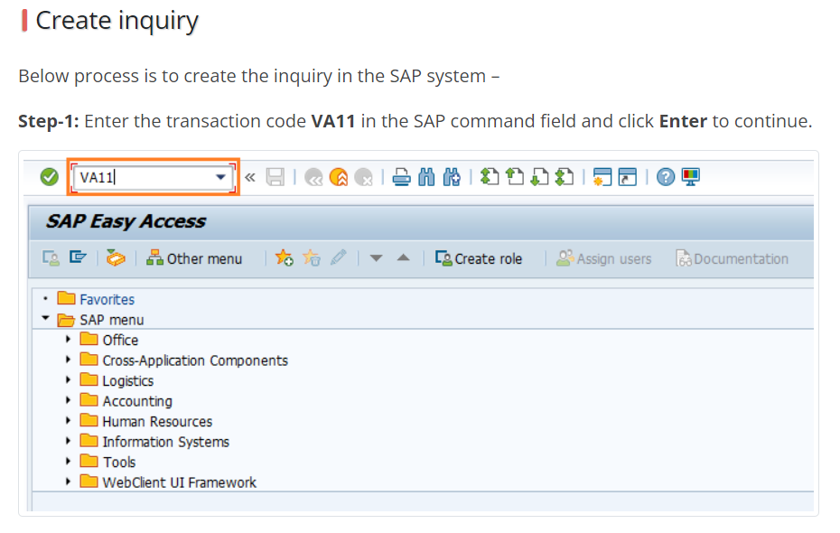
ORDER TO CASH

Slide 79
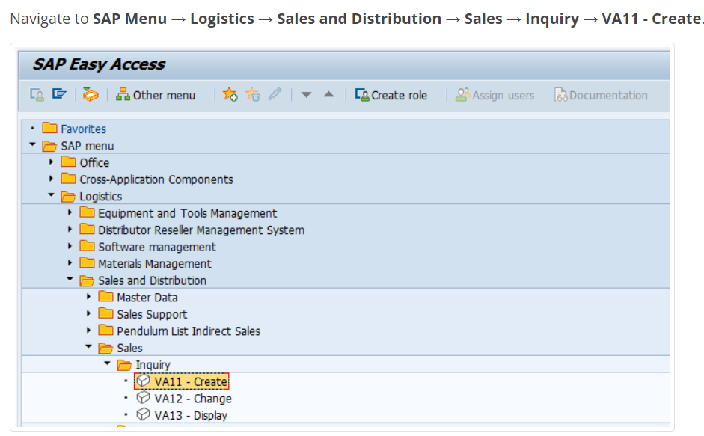

Slide 80
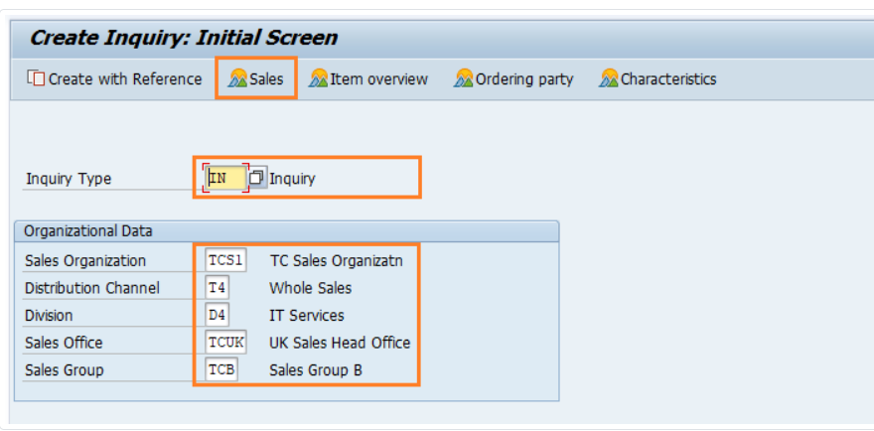

Slide 81
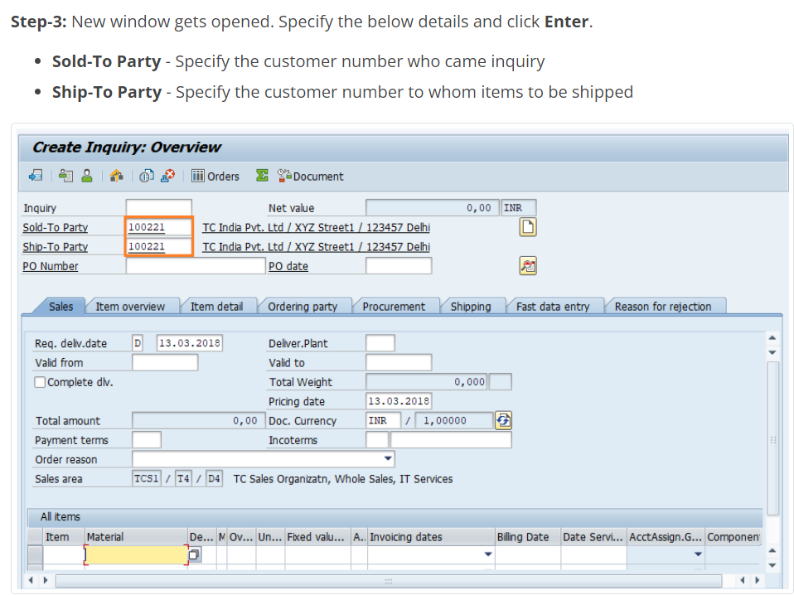

Slide 82
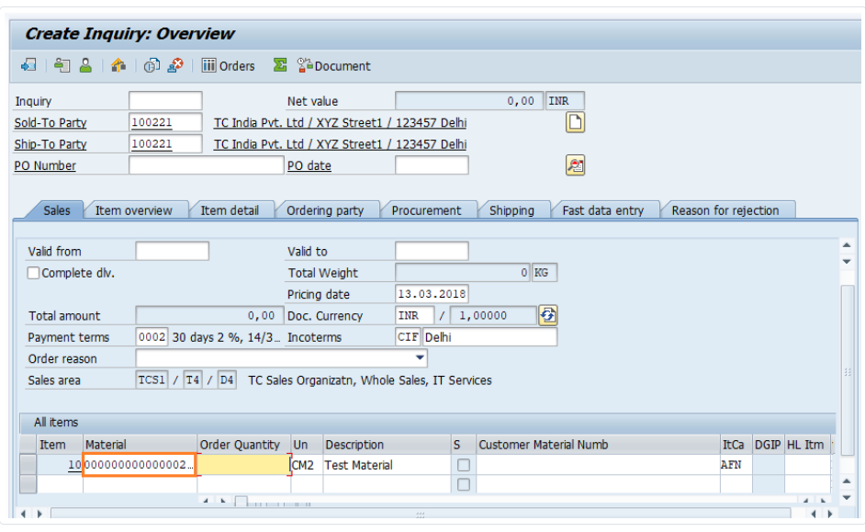

Slide 83
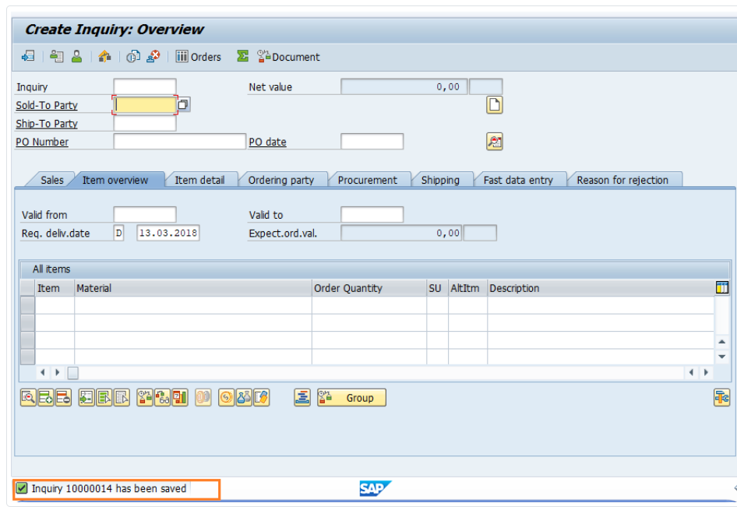

Slide 84
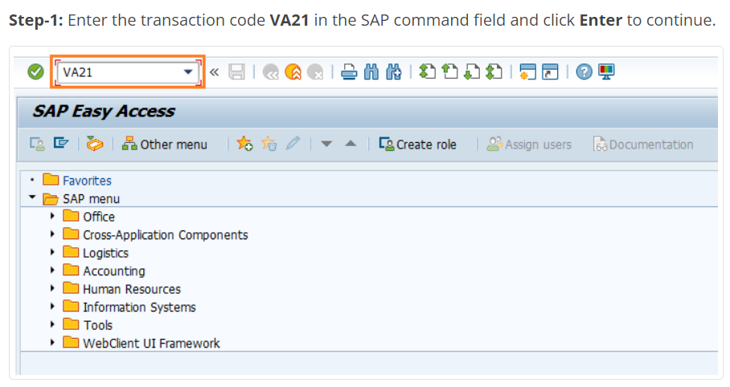
Creation of quotation

Slide 85
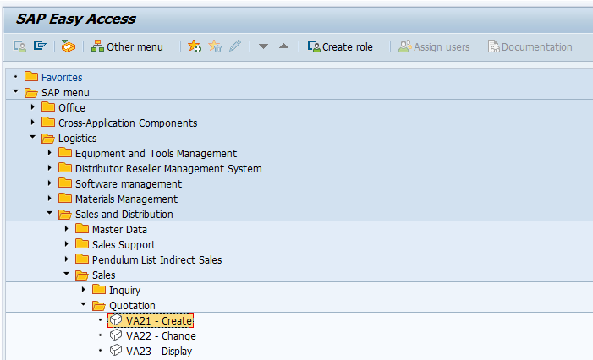

Slide 86
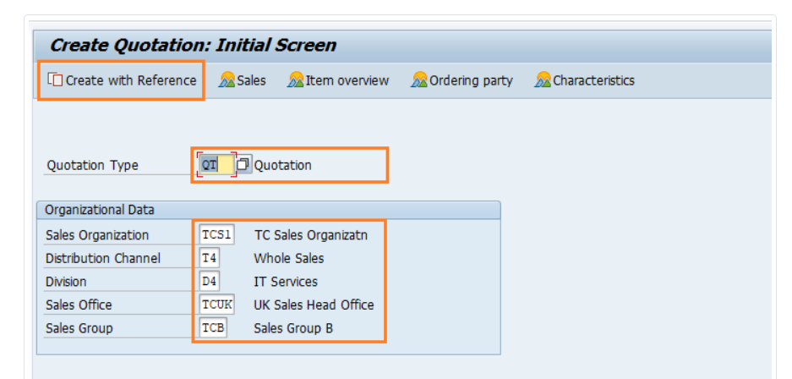

Slide 87
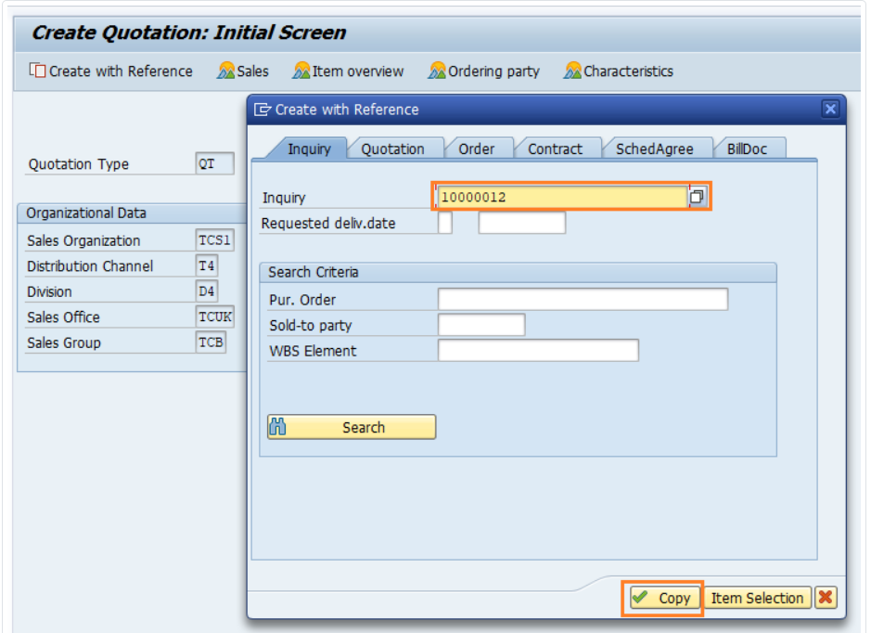

Slide 88
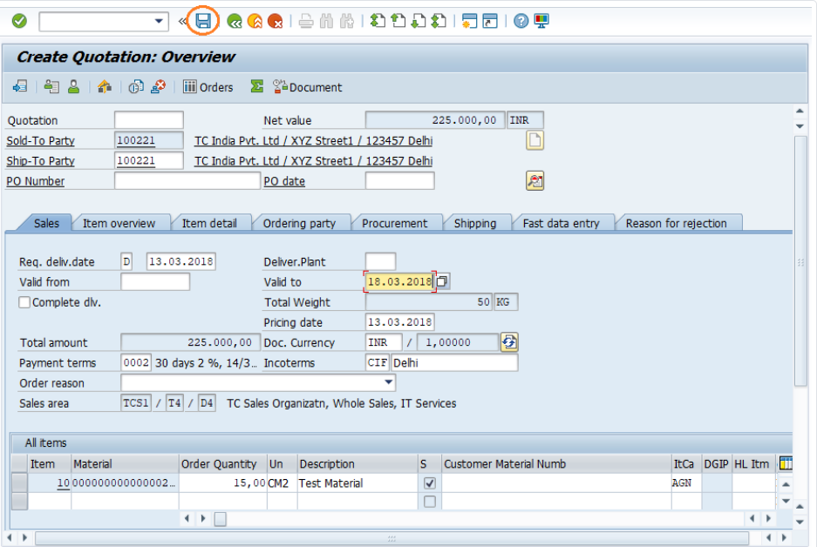

Slide 89
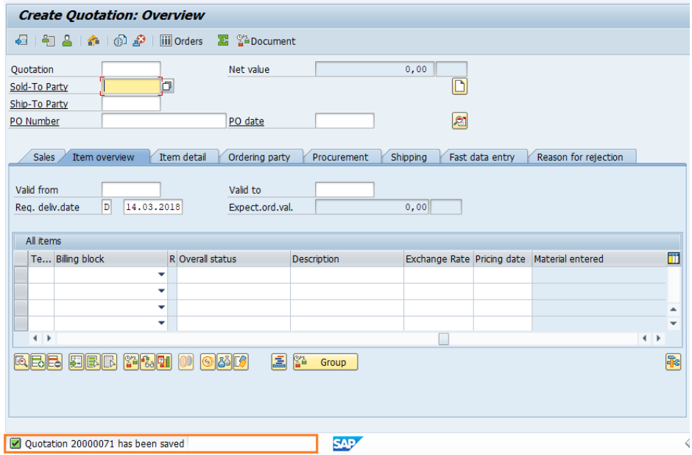

Slide 90

SALES ORDER

Slide 91


Slide 92


Slide 93


Slide 94


Slide 95


Slide 96

OUTBOUND DELIVERY

Slide 97

TRANSFER ORDER

Slide 98

CREATE BILLING

Slide 99


Slide 100
THANK YOU

